Slide 1




NBA GAME - PREDICTION
A DATA-DRIVEN APPROACH TO FORECASTING BASKETBALL RESULTS
TEAM:
JETENDRA MULINTI
GOUTHAM VEMULA
PRAJEETH NAKKA
MAY. 08 | 24

Slide 2



TABLE OF CONTENTS
Introduction
Problem Statement
Data Collection and Preprocessing
Exploratory Data Analysis
Feature Selection and Engineering
Model Development and Evaluation
Ensemble Modeling
Results and Discussion
Future Work
Conclusion

Slide 3
INTRODUCTION
The National Basketball Association (NBA) is a highly competitive professional basketball league that captivates fans worldwide. Each season, teams strive to outperform their opponents and secure victories on the court. Predicting the outcomes of NBA games has become increasingly important for various stakeholders, including team managers, coaches, sports analysts, and fans.
Accurate game outcome predictions can provide valuable insights for decision-making, such as player roster selections, game strategies, and resource allocation. By leveraging the power of machine learning and data analytics, we aim to develop a robust predictive model that can forecast NBA game results based on historical game statistics and other relevant factors.
In this project, we set out to achieve the following objectives:
Collect and preprocess a comprehensive dataset of NBA game statistics from reliable sources.
Conduct exploratory data analysis to uncover patterns, trends, and key performance indicators.
Develop and evaluate various machine learning models to predict game outcomes accurately.
Identify the most influential factors that contribute to determining the winning team.

Slide 4
PROBLEM STATEMENT
The primary problem we aim to address in this project is predicting the outcome of NBA games based on historical game statistics and other relevant factors. Accurately forecasting game results is a complex task due to the multitude of variables involved, such as player performance, team dynamics, and contextual factors.
Research Questions: To guide our analysis and modeling approach, we have identified the following research questions:
Can historical NBA game statistics be effectively utilized to predict the outcome of future games?
We hypothesize that past game data contains valuable patterns and trends that can be leveraged to forecast game results.
What are the most influential factors in determining the winning team?
By identifying the key variables that have a significant impact on game outcomes, we can focus our modeling efforts on the most relevant features.
Can the prediction model adapt dynamically to in-season changes, such as player performance trends?
NBA seasons are dynamic, with player performances and team strategies evolving over time. We aim to develop a model that can adapt to these changes and provide accurate predictions throughout the season.
How does the home-court advantage factor into the predictive model?
Home-court advantage is widely recognized as a significant factor in NBA games. We seek to quantify its impact and incorporate it effectively into our predictive model.

Slide 5
Data COLLECTION AND PREPROCESSING
To develop a robust predictive model, we collected a comprehensive dataset of NBA game statistics from the reliable source, Basketball Reference. The data was scraped using Selenium and Python, ensuring the accuracy and completeness of the information.
Key points about the data collection and preprocessing phase:
Data Source: Basketball Reference website (https://www.basketball-reference.com/)
Data Coverage: Last 4 NBA seasons (2020-2023), totaling approximately 5000 games
Data Scraping: Utilized Selenium and Python to automate the data extraction process
Data Cleaning and Preprocessing:
We’ve removed duplicates, null values and few un necessary columns.
Feature Selection: Identified relevant features based on domain knowledge and statistical significance
By collecting and preprocessing the NBA game statistics data, we established a solid foundation for our exploratory data analysis and subsequent modeling tasks.

Slide 6


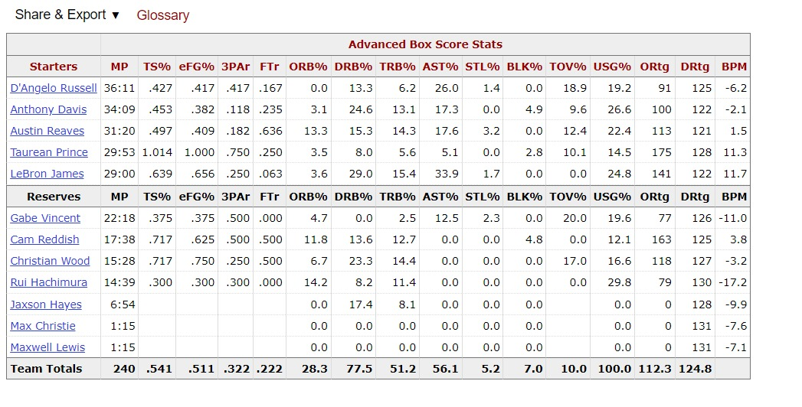
DATA COLLECTION AND PREPROCESSING

Slide 7
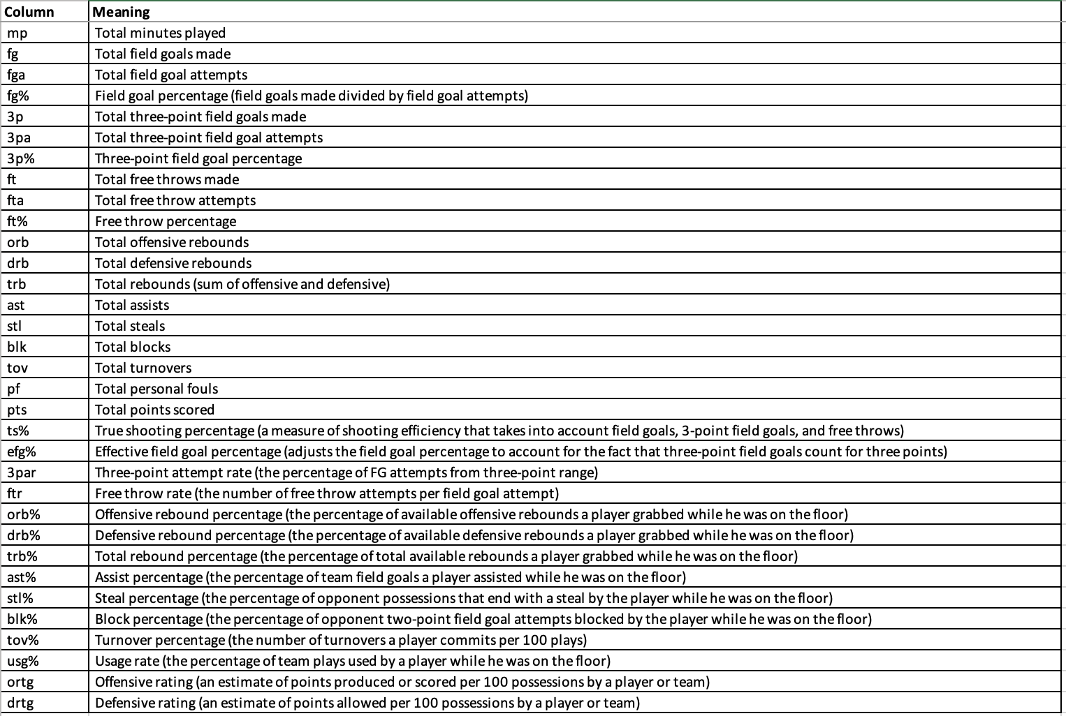
Data Dictionary

Slide 8
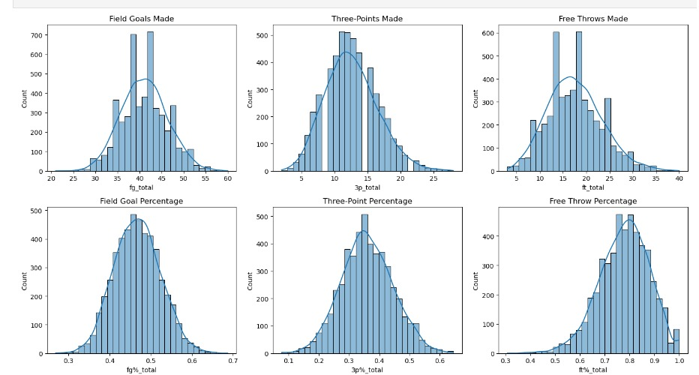
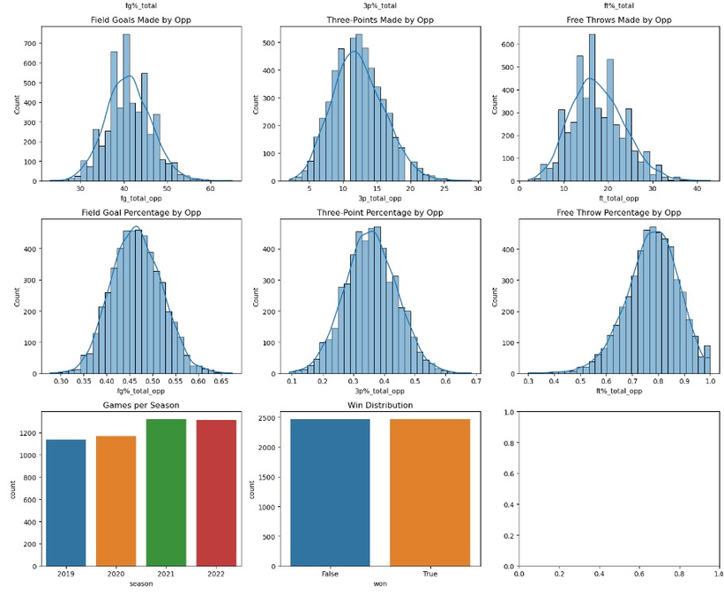
EXPLORATORY DATA ANALYSIS (EDA)

Slide 9
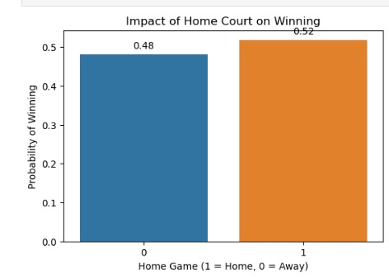
EXPLORATORY DATA ANALYSIS (EDA)
Lag features and home ground advantage
the rolling average of the last 3 games appears to be the most suitable for predicting the current game's outcome. It captures the team's recent performance without being overly influenced by a single game, while still being responsive to recent changes

Slide 10
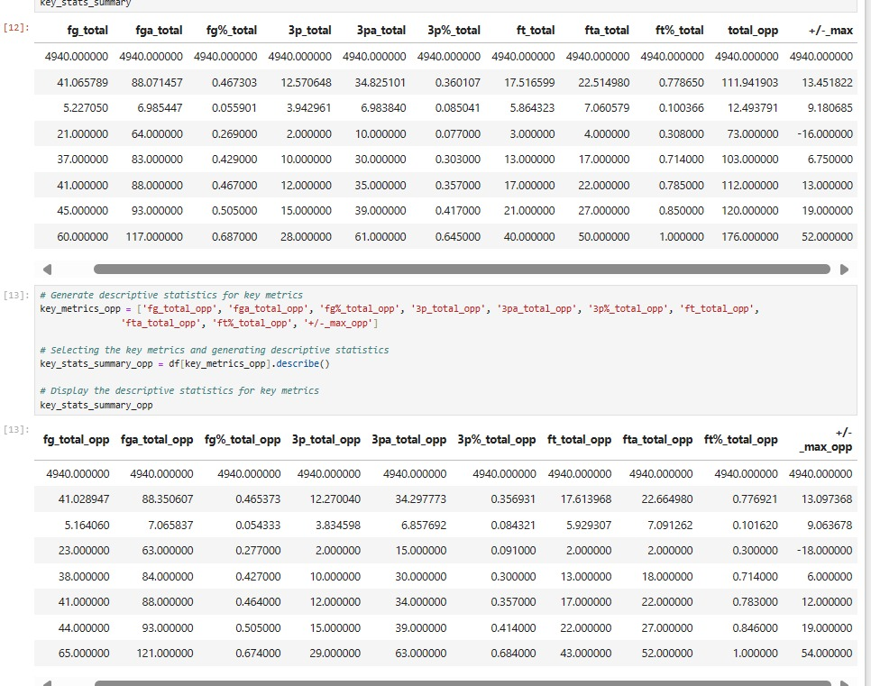
Shooting Efficiency:
Opponents showcase strong shooting efficiency, with an average field goal percentage of 46.53% (fg%_total_opp) and three-point percentage of 35.69% (3p%_total_opp), emphasizing the need for robust defensive strategies.
Opponent Offensive Strengths:
Opponents excel at drawing fouls, attempting an average of 22.65 free throws per game (fta_total_opp) while maintaining a high free throw percentage of 77.69% (ft%_total_opp).
Their offensive rebounding ability (fg%_total_opp: 46.53%) and three-point scoring prowess further contribute to their offensive threat.
Plus-Minus Indicator:
The average +/- score of opponents (+/-_max_opp: +9.06) indicates their substantial impact on game outcomes, with a wide range from -18 to +54, underscoring the importance of strategically controlling key performance metrics.

Slide 11
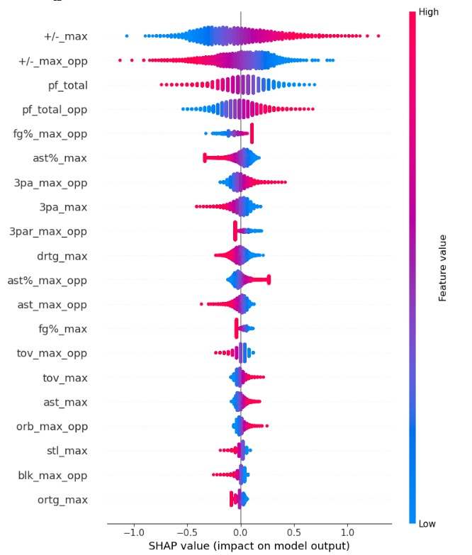
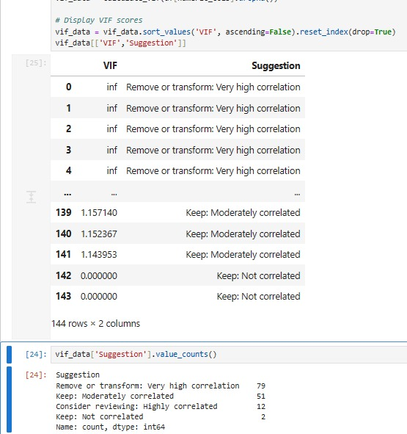
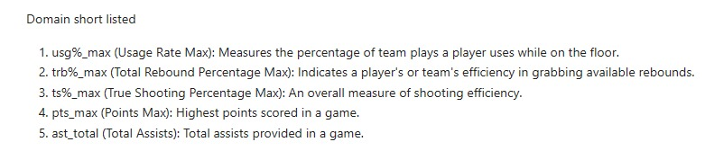
FEATURE SELECTION AND ENGINEERING
SHAP (SHapley Additive exPlanations) is a game theory-based approach to explain the output of machine learning models by determining the contribution of each feature to the prediction. It assigns importance values to each feature for a particular prediction, allowing for model interpretability and understanding of the impact of individual features on the model's output.

Slide 12
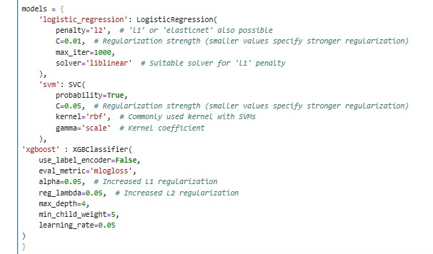
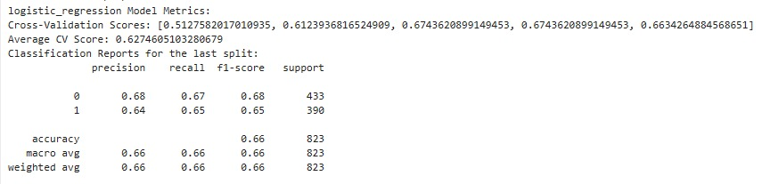
MODEL DEVELOPMENT AND EVALUATION

Slide 13
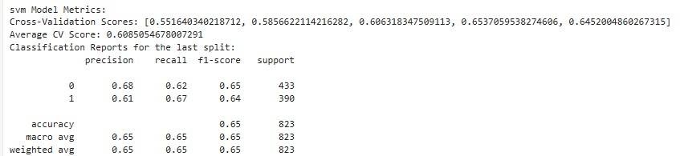
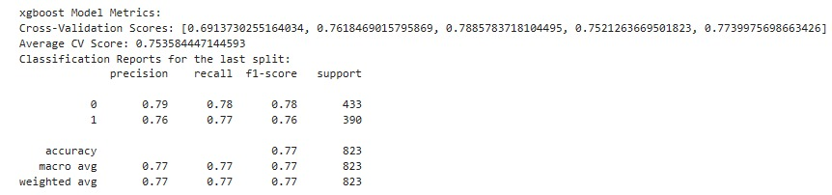
MODEL DEVELOPMENT AND EVALUATION

Slide 14
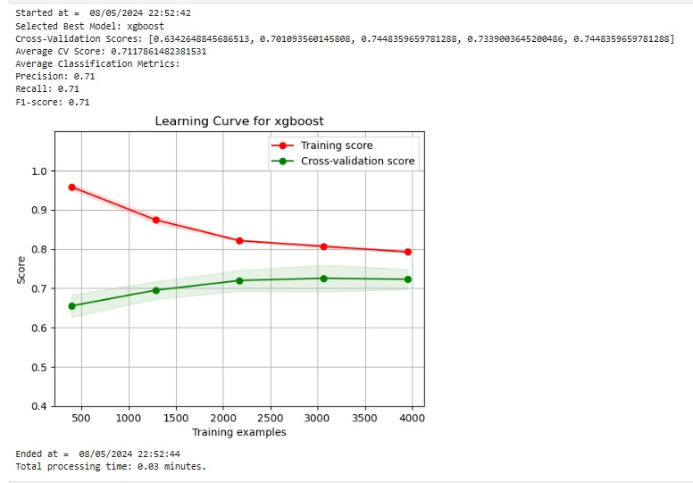
MODEL EVALUATION

Slide 15
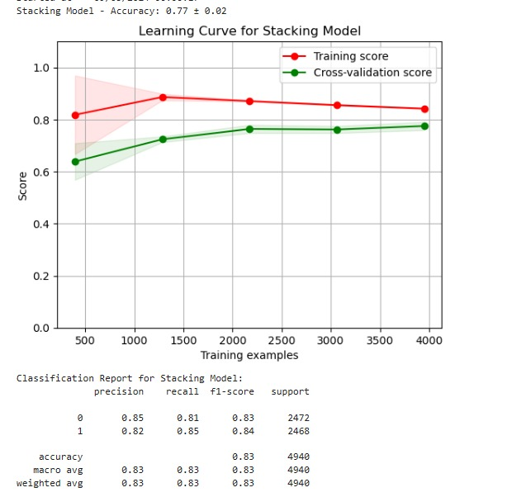
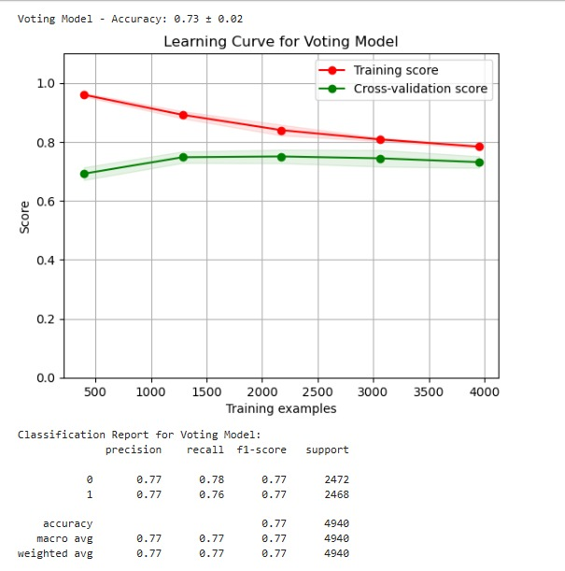
ENSEMBLE MODELING
Among the two ensemble methods, Stacking Model and Voting Model, the Stacking Model has shown superior performance for this use case. It achieved a higher cross-validation score (0.72 ± 0.03) compared to the Voting Model (0.71 ± 0.03) and displayed a well-balanced learning curve, indicating a better generalization and less overfitting.
Stacking is an ensemble technique that combines the predictions of multiple base models using a meta-model to make the final prediction.
Voting is an ensemble technique that combines the predictions of multiple models by taking the average (for regression) or the majority vote (for classification) of their individual predictions.

Slide 16
RESULTS AND DISCUSSION
After developing and evaluating various machine learning models, including Logistic Regression, Support Vector Machines (SVM), and XGBoost, we obtained promising results in predicting NBA game outcomes.
Key findings:
Model Performance:
The XGBoost model emerged as the best-performing individual model, achieving an average cross-validation accuracy of 74%.
The ensemble model which is generalised, combining Logistic Regression, SVM, and XGBoost using stacking, further improved the accuracy to (0.77 ± 0.03)
Feature Importance:
The SHAP (SHapley Additive exPlanations) analysis revealed the most influential features for predicting game outcomes, including (± max), (± max_opp), pf_total, pf_total_opp and number of three-point shots made (3p_total).
These features emphasize the importance of shooting efficiency and offensive production in determining the winning team.
In-Season Adaptability:
By incorporating rolling averages of key performance metrics, such as points scored, our model demonstrated the ability to adapt to in-season changes and capture the dynamic nature of player and team performances.
The results highlight the effectiveness of machine learning techniques in predicting NBA game outcomes and provide valuable insights into the key factors influencing team success.
Home-Court Advantage:
Our analysis confirmed the significant impact of home-court advantage on game outcomes, with home teams having a higher probability of winning compared to away teams.

Slide 17
FUTURE WORK
Incorporating Player-Level Data:
Integrating player-specific statistics, such as individual player performance metrics and injury data, could provide a more granular understanding of game outcomes.
Exploring the impact of key players' absences or performances on game results would add depth to the predictive model.
Expanding Data Sources:
Augmenting the dataset with additional data sources, such as player tracking data, could offer insights into player movements, shot selections, and defensive strategies.
Incorporating external factors, such as team travel schedules and rest days, may further enhance the model's predictive power.
Real-Time Predictions:
Developing a real-time prediction system that incorporates live game data would enable dynamic and up-to-date forecasting of game outcomes.
This would require integrating live data feeds and optimizing the model for real-time performance.
Deployment and Visualization:
Creating an interactive web application or dashboard to visualize the model's predictions and key insights would make the findings more accessible and user-friendly.
Deploying the model as a service would allow stakeholders to access and utilize the predictions easily.

Slide 18
CONCLUSION
In conclusion, our project successfully demonstrates the application of machine learning techniques to predict NBA game outcomes. By leveraging historical game statistics and advanced analytics, we developed a robust predictive model that provides valuable insights into the factors influencing team success.
Key takeaways:
Machine learning models, particularly the XGBoost model and the ensemble approach, achieved promising accuracies in predicting NBA game outcomes.
The identification of influential features, such as shooting efficiency and offensive production, highlights the key areas teams should focus on to increase their chances of winning.
The significant impact of home-court advantage on game outcomes emphasizes the importance of leveraging home-court benefits and developing strategies to mitigate its effects when playing away.
The model's ability to adapt to in-season changes by incorporating rolling averages of performance metrics showcases its potential to capture the dynamic nature of player and team performances.

